Slide 1
Design Patterns
Title : Pizza ordering system using builder pattern
Team Details
19MIS0068 - Shanmuga Mayan
19MIS0086 - Arun Kumar
19MIS0102 - Deepan.S

Slide 2
Abstract
Design patterns are typical solutions to common problems in software design.
Each pattern is like a blueprint that you can customize to solve a particular design problem in your code.
Patterns are a toolkit of solutions to common problems in software design.

Slide 3
Introduction
The Builder design pattern is one of the creational design patterns that describe how to solve recurring design problems in object-oriented software
The Builder design pattern describes how to solve such problems :
Encapsulate creating and assembling the parts of a complex object in a separate Builder object.
A class delegates object creation to a builder object instead of creating the objects directly.

Slide 4
Intent
Separate the construction of a complex object from its representation so that the same construction process can create different representations.

Slide 5
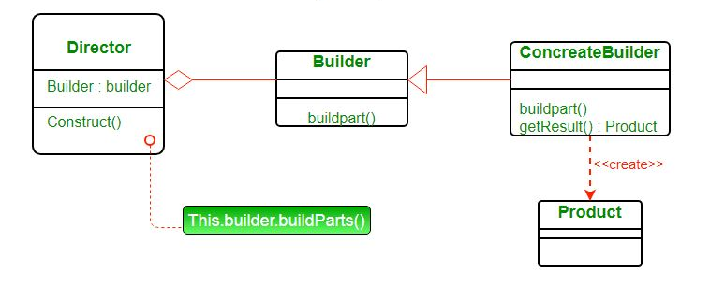
Structure

Slide 6
Collaborations
The client creates the Director object and configures it with the desired Builder object.
Director notifies the builder whenever a part of the product should be built.
Builder handles requests from the director and adds parts to the product.
The client retrieves the product from the builder.

Slide 7
Consequences
It lets you vary a product's internal representation
It isolates code for construction and representation
It gives you finer control over the construction process

Slide 8
Implementation issues
Assembly and construction interface
Why no abstract class for products
Empty methods as default in Builder

Slide 9
System Implementation
In the present scenario we have implemented the following code in java
First, we have created an interface Item that represents the Veg and Non Veg Pizza.
Now, created concrete sub-classes SmallCheezePizza, MediumCheezePizza, LargeCheezePizza, ExtraLargeCheezePizza that will extend to the abstract class VegPizza. Similarly, we have created for NonVegPizza.
Now we have created an OrderBuilder class that will be responsible to create the objects of OrderedItems class.
At last, we have created BuilderDemo class which uses orderbuilder class to show the cost os the items we have ordered and show the items we have ordered

Slide 10
THANK YOU 😊

